Slide 1


Everyday AI for Non-Profit Leaders
Bill Blum
CEO and Founder
www.alpinebiz.com
908.707.9696

Slide 2

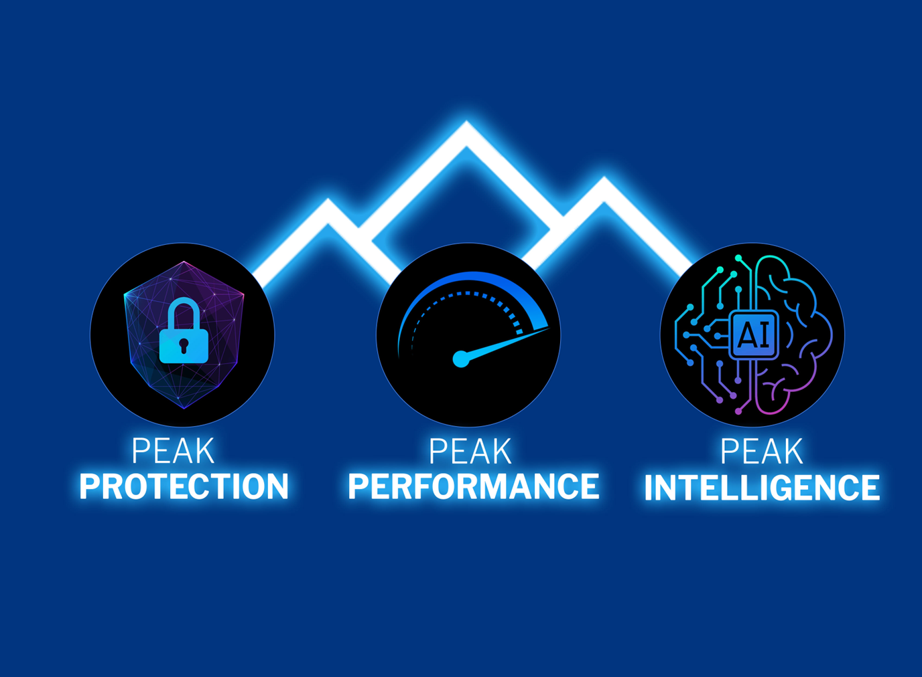

Slide 3
Agenda
The Big 6 Models
Why Microsoft Copilot?
Copilot Chat versus M365 Copilot
Prompting Best Practices
Microsoft Videos
How to Get Started
Agentic AI
Peak Intelligence -Your 3-Step AI Plan
www.alpinebiz.com
908.707.9696

Slide 4
Do you use AI as an assistant multiple times:
Day Week Month?
Chat GPT, Copilot, Claude, Gemini, Perplexity, Grok
Do you use AI Agents?
Do you create them?
Openclaw?
AI Policy?
www.alpinebiz.com
908.707.9696

Slide 5
Artificial Intelligence
“A new Digital Species”
Mustafa Suleyman
Microsoft AI CEO
Anthropic’s Claude has
“171 distinct emotional states”
www.alpinebiz.com
908.707.9696

Slide 6
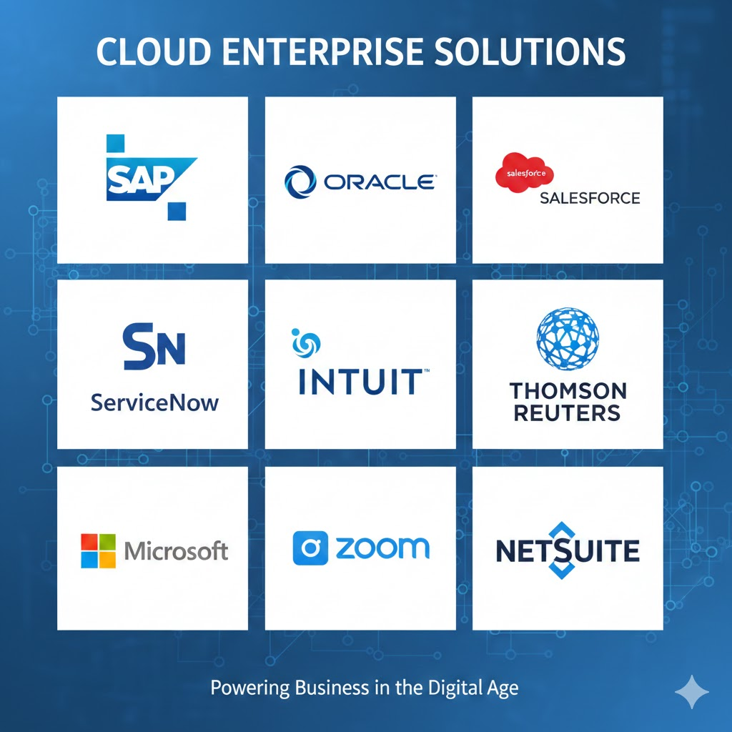
All business apps now have embedded AI
www.alpinebiz.com
908.707.9696

Slide 7
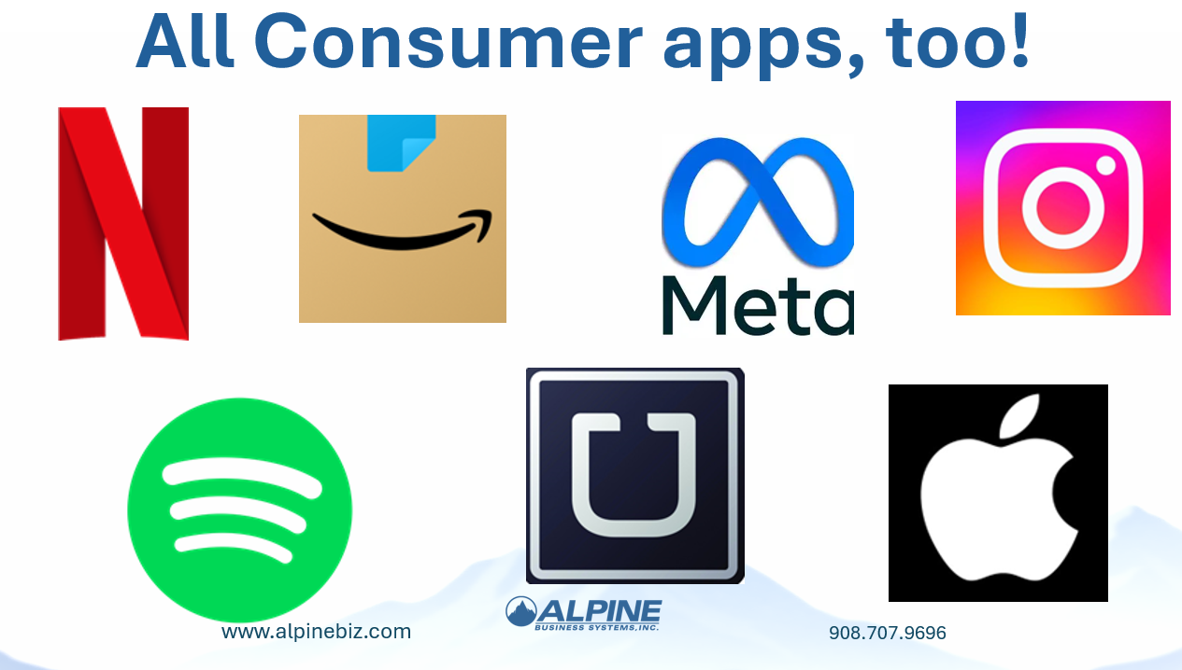
www.alpinebiz.com
908.707.9696

Slide 8

www.alpinebiz.com
908.707.9696

Slide 9
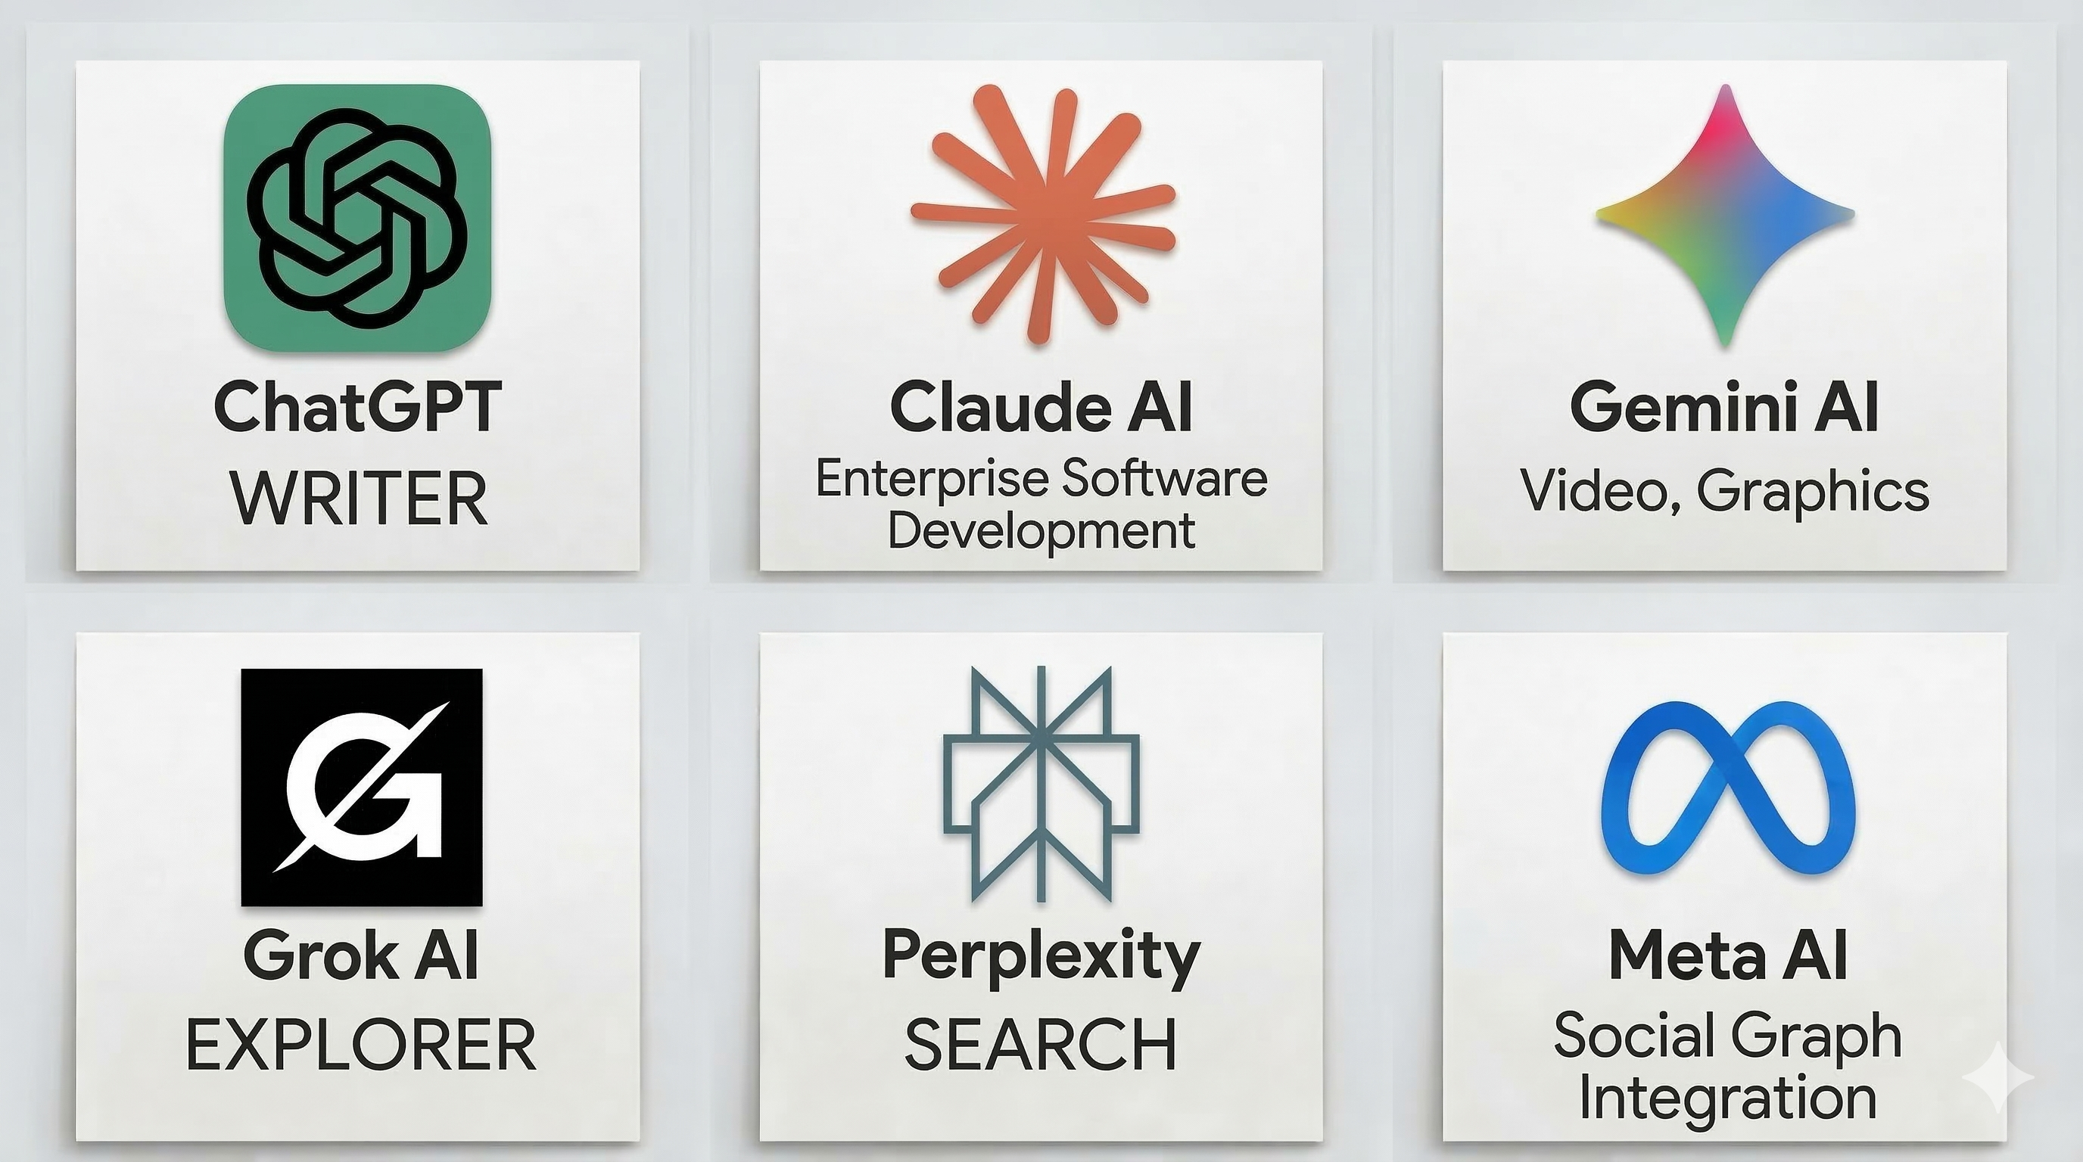
www.alpinebiz.com
908.707.9696

Slide 10
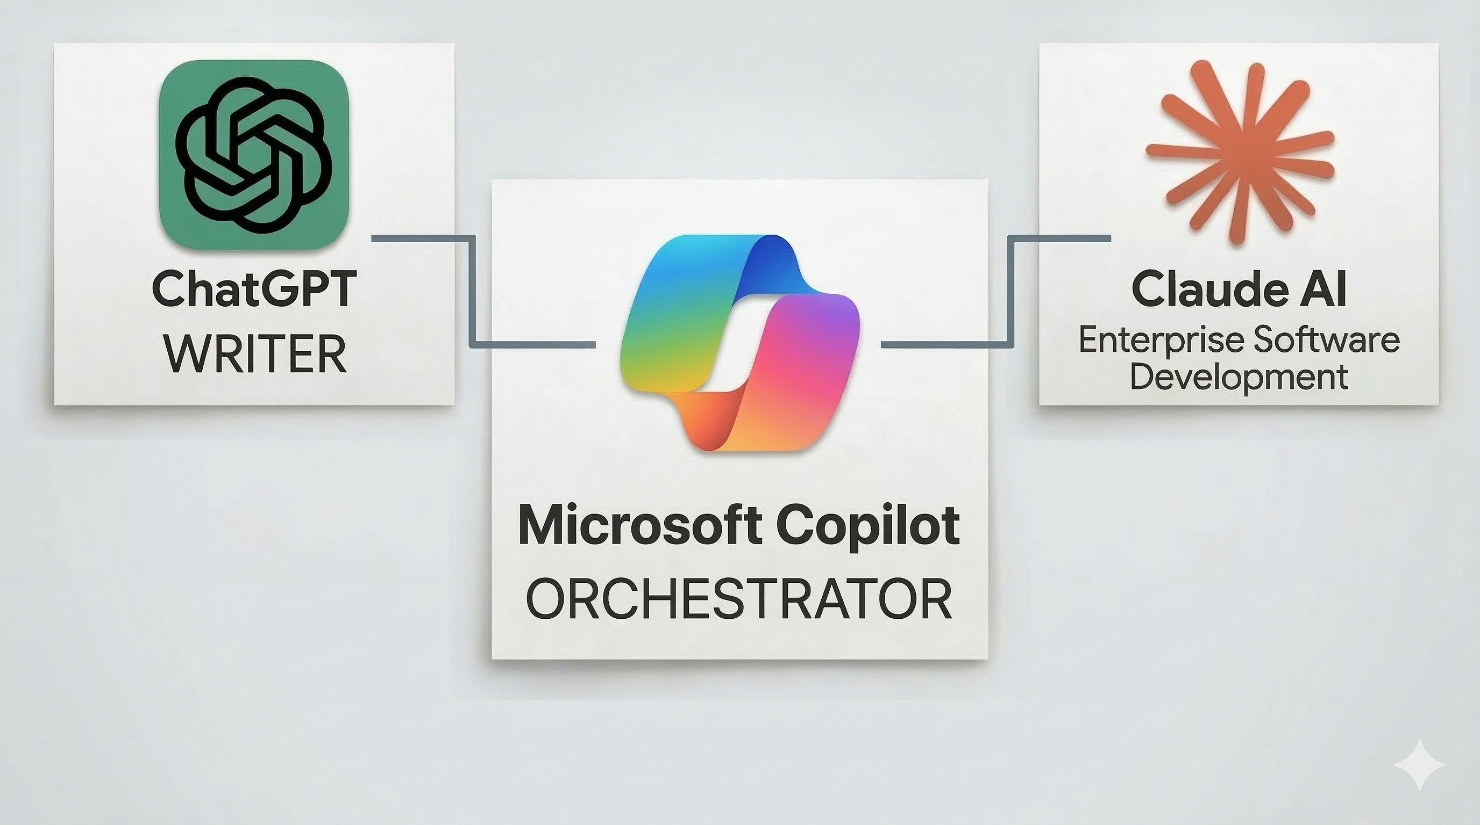
www.alpinebiz.com
908.707.9696

Slide 11
Why Microsoft 365 Copilot?
    Security
    Governance and
    compliance
    Privacy
Honors your existing permissions
Ramp your data preparedness for AI
You control your data
Persistent label inheritance
and DLP policies
Detect and investigate
non-compliant usage
You control your
data location
Risk-based conditional access
and endpoint management
Granular controls and transparency for web queries
Your data isn’t used to train foundation models
Notes:
Early on we made the decision to differentiate Copilot as the most secure and trusted AI solution in the market.
Copilot honors your existing Microsoft 365 permissions and policies for data access.
Your sensitive data is protected, respecting your existing labels and DLP policies, along with conditional access and endpoint management.
With Copilot, you’re in control of your data. Your data is encrypted at rest and in transit.
You also control your data’s location which is especially important for customers in the EU.
And unlike other AI vendors, we don’t use your data to train the foundational LLM models.

Slide 12


Copilot Chat vs. M365 Copilot
FREE $30 / month
Both are Secure
www.alpinebiz.com
908.707.9696

Slide 13
Elements of a good prompt
  Goal: Clearly define the outcome
  Context: Provide as much info as possible
  Source: Provide the data it needs
  Expectations: Tone, output format, what you don’t want
www.alpinebiz.com
908.707.9696

Slide 14
Excel Sample Prompt
Prompt: “Review the quarterly sales dataset in this workbook. Clean any duplicate entries, standardize the date formats, and create a summary table that shows total revenue, average deal size, and top performing regions for Q4. Present all output on a new worksheet labeled ‘Q4 Summary.”
Purpose: Data cleanup, transformation, and summarization.
Why it’s a good prompt
Goal: Clean and summarize sales data.
Context: Quarterly sales, duplicates, dates, Q4 analysis.
Source: The current workbook.
Expectations: New worksheet, labeled results, specific metrics.
www.alpinebiz.com
908.707.9696

Slide 15
Word Sample Prompt
Prompt: “Rewrite the attached project update so it’s concise, executive-friendly, and suitable for a board packet. Keep the tone professional and remove unnecessary technical details while maintaining key metrics and timelines.”
Purpose: Improve clarity, tone, and conciseness.
Why it’s a good prompt
Goal: Rewrite for executive audience.
Context: Project update → board packet.
Source: Attached document.
Expectations: Concise, professional, nontechnical.
www.alpinebiz.com
908.707.9696

Slide 16
PowerPoint Sample Prompt
Prompt:
“Create a 10 slide PowerPoint outline for a Q4 performance review. Include slides for revenue trends, key wins, major challenges, customer churn, operational updates, and goals for next quarter. Use a simple, executive-ready tone and propose visuals for each slide.”
Purpose: Generate a structured deck outline.
Why it’s a good prompt:
Goal: Build a Q4 review briefing.
Context: Revenue, churn, operations, forward planning.
Source: Q4 information (not proprietary data).
Expectations: 10 slides with slide-by-slide visuals.
www.alpinebiz.com
908.707.9696

Slide 17
Outlook Sample Prompt
Prompt:
“Summarize this email thread in 5 bullet points. Highlight decisions made, open questions, deadlines, and action items I’m responsible for.”
Purpose: Quickly understand a long conversation.
Why it’s a good prompt
Goal: Summarize.
Context: Decisions + actions.
Source: The email thread.
Expectations: 5 bullets, highlight responsibilities.
www.alpinebiz.com
908.707.9696

Slide 18
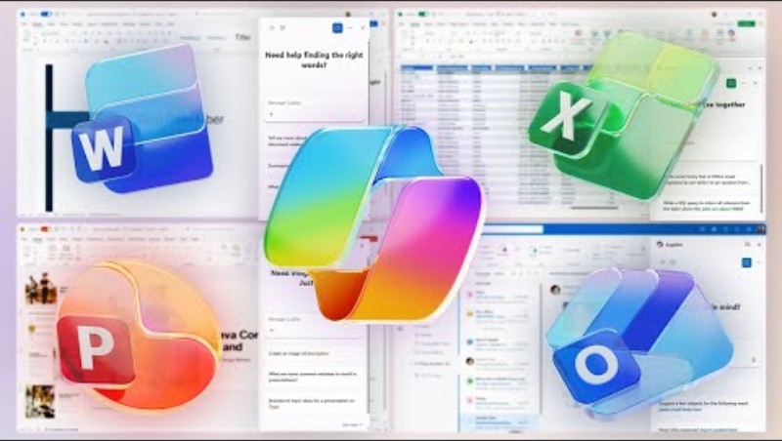

Slide 19
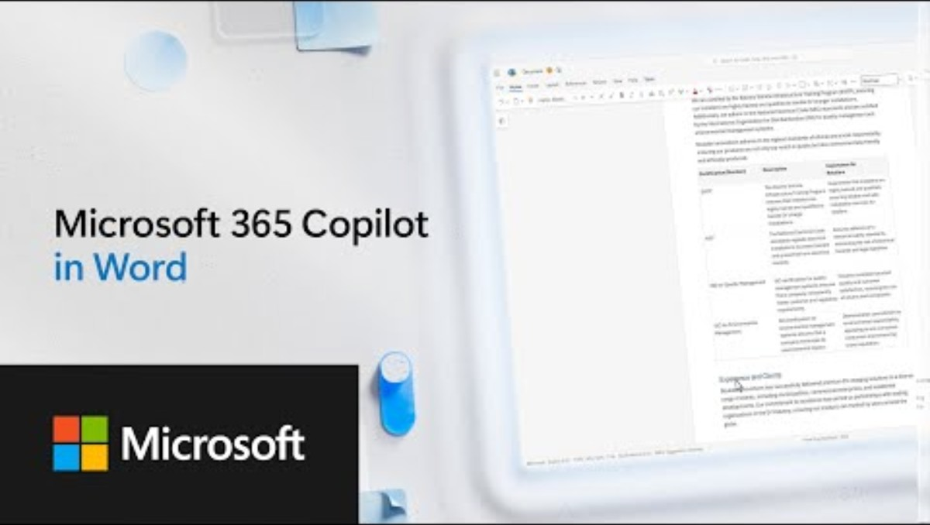
www.alpinebiz.com
908.707.9696

Slide 20
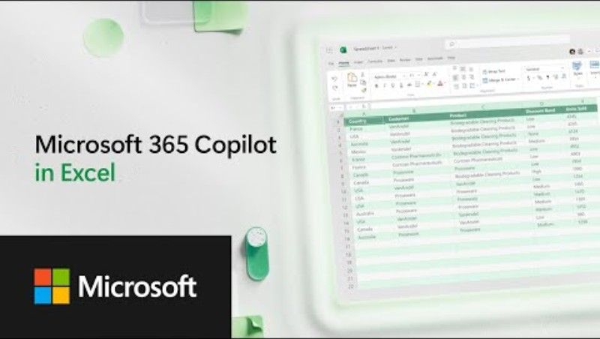
BODY
<iframe width="560" height="315" src="https://www.youtube.com/embed/YNcIN_bXpuA?si=pCvb66F-vucARvjo" title="YouTube video player" frameborder="0" allow="accelerometer; autoplay; clipboard-write; encrypted-media; gyroscope; picture-in-picture; web-share" referrerpolicy="strict-origin-when-cross-origin" allowfullscreen></iframe>
www.alpinebiz.com
908.707.9696

Slide 21
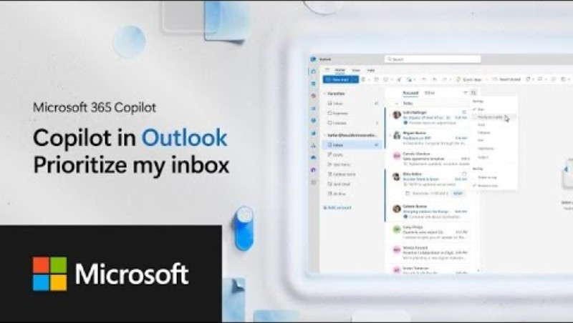

Slide 22
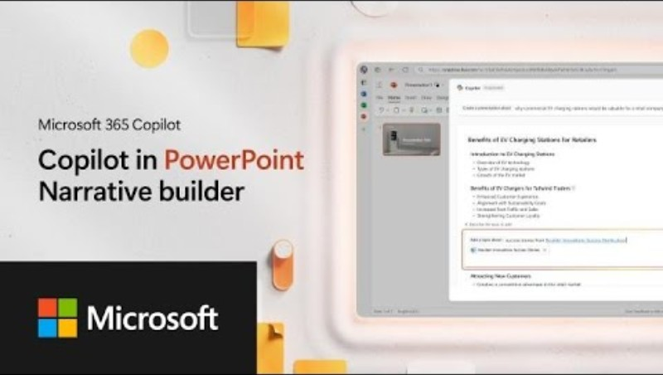

Slide 23
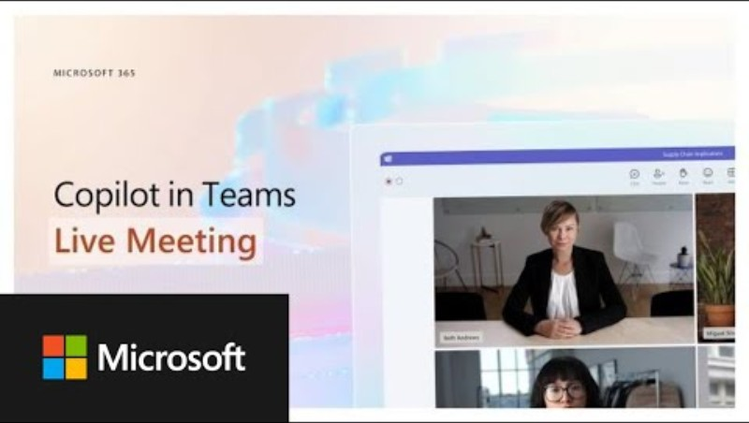

Slide 24

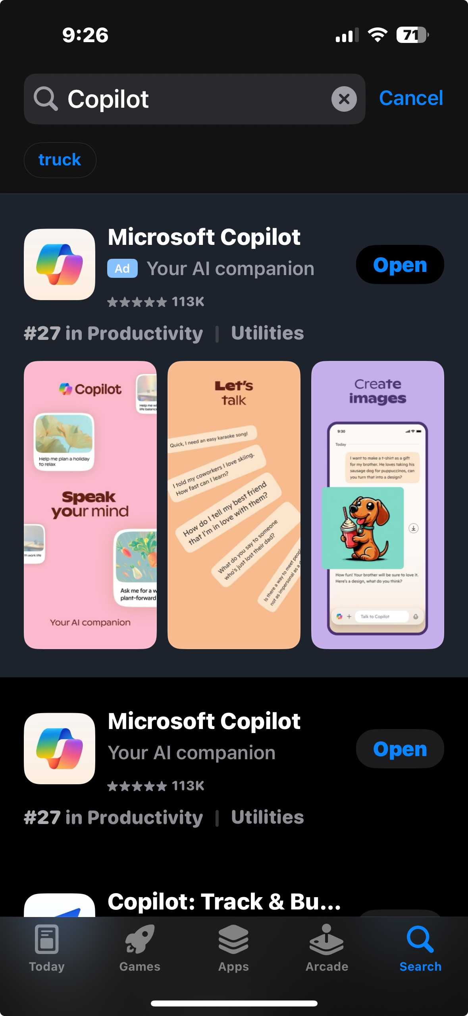
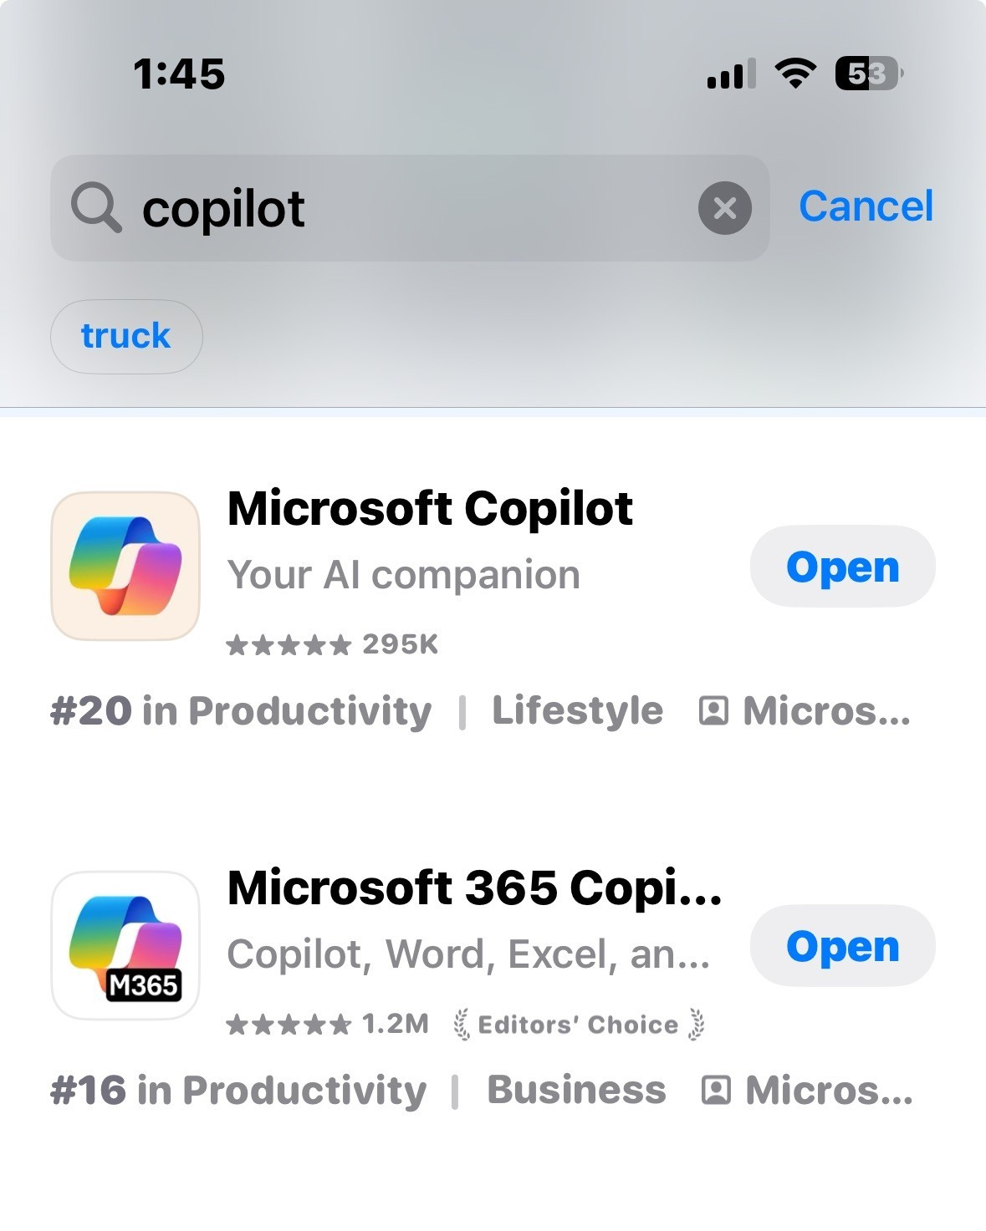
Download the App!
&
Use it!
Notes:
9:20

Slide 25

On your computer:
Search Copilot
Pin it to Taskbar
www.alpinebiz.com
908.707.9696

Slide 26
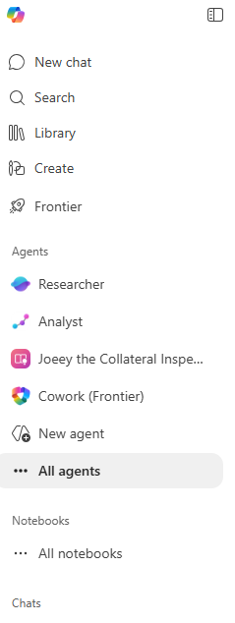
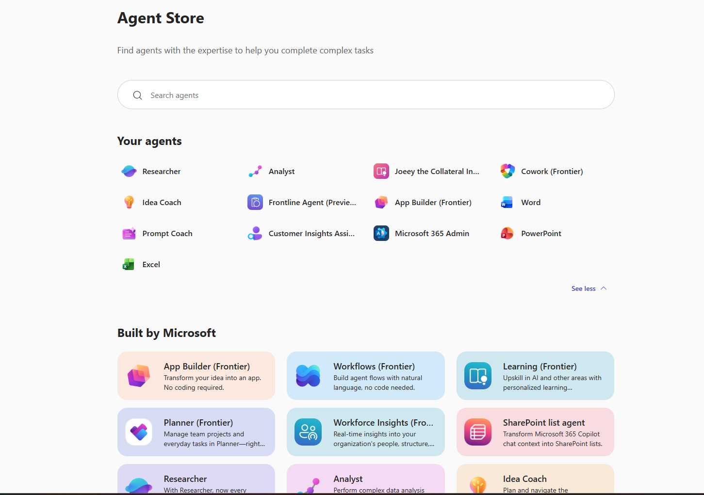
www.alpinebiz.com
908.707.9696

Slide 27
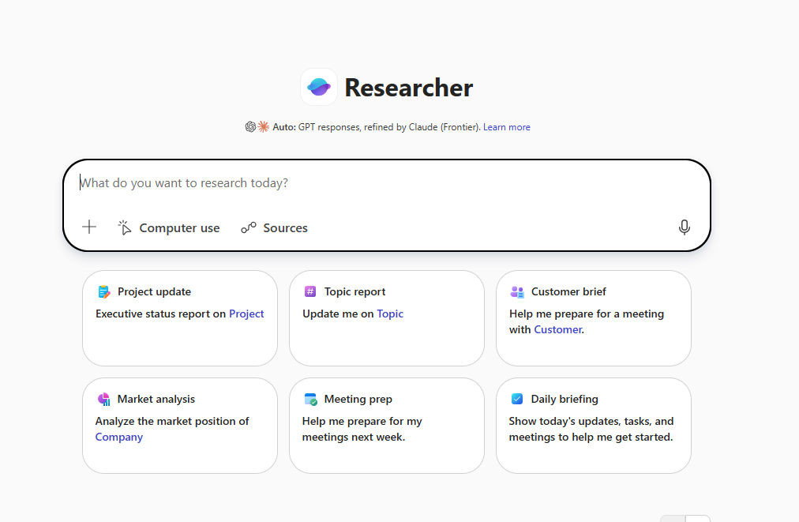
www.alpinebiz.com
908.707.9696

Slide 28
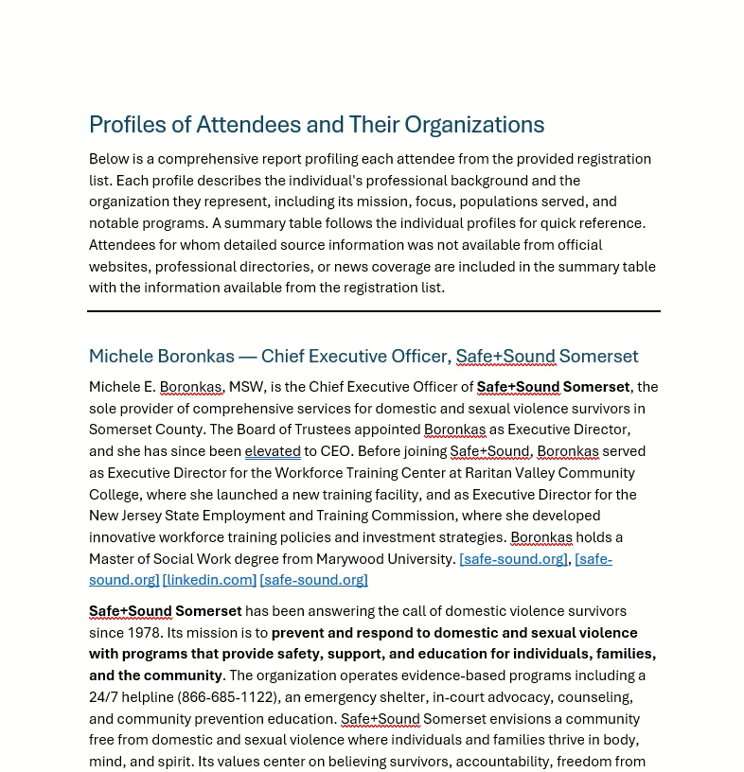
www.alpinebiz.com
908.707.9696

Slide 29
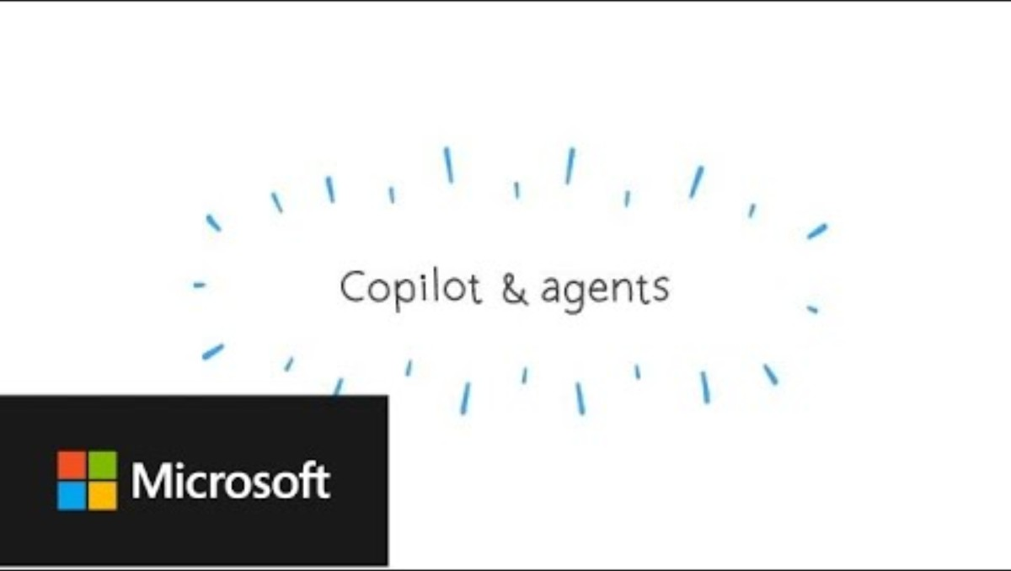

Slide 30
The Problem:
Tracking OKR’s
The Solution:
AI – Generated App
www.alpinebiz.com
908.707.9696

Slide 31
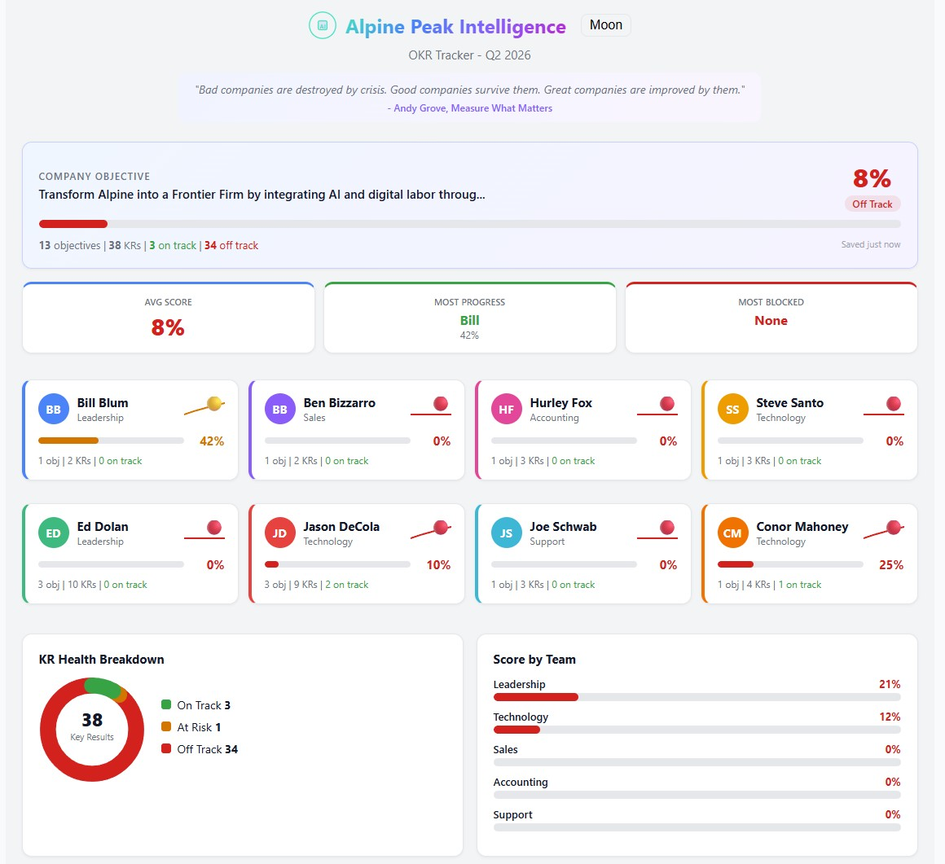
www.alpinebiz.com
908.707.9696

Slide 32
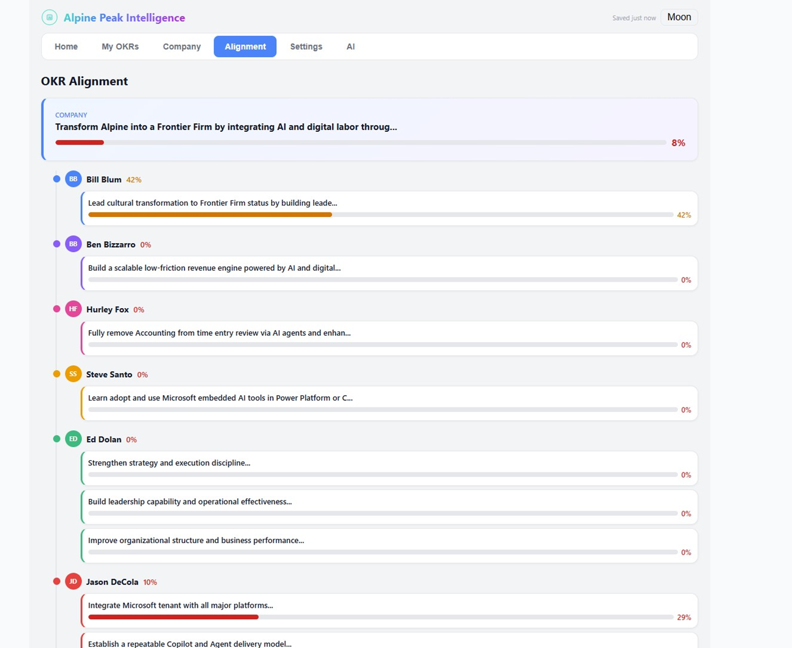
www.alpinebiz.com
908.707.9696

Slide 33
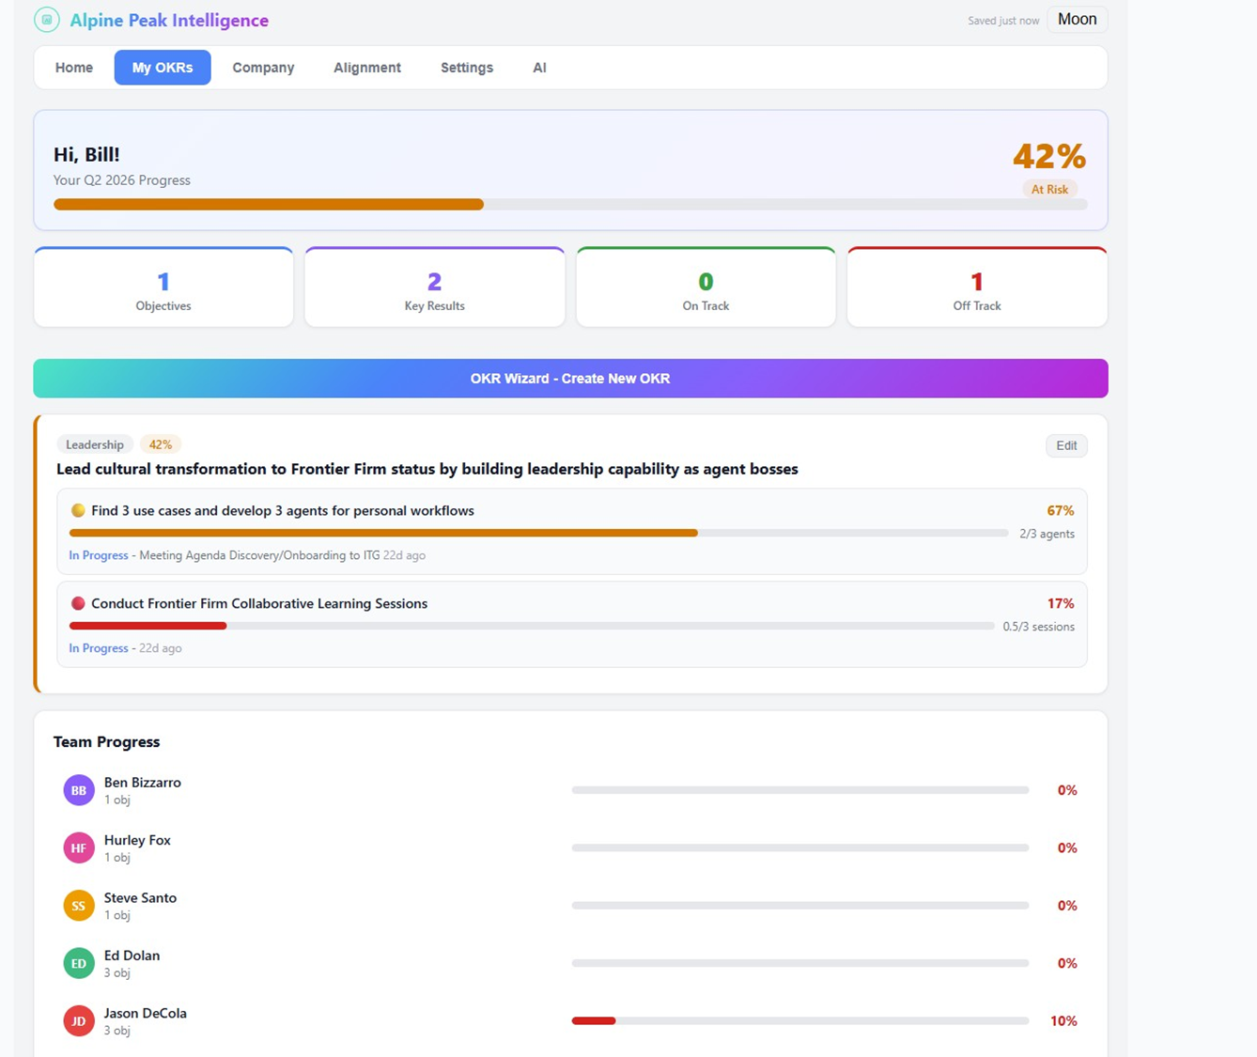
www.alpinebiz.com
908.707.9696

Slide 34
The Problem:
Incorrect Timesheet Entries
The Solution:
Agentic AI
www.alpinebiz.com
908.707.9696

Slide 35
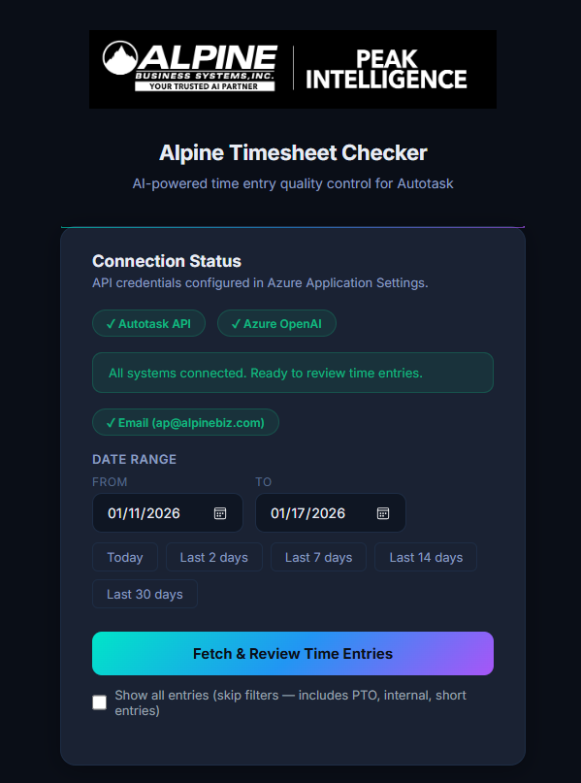
www.alpinebiz.com
908.707.9696

Slide 36
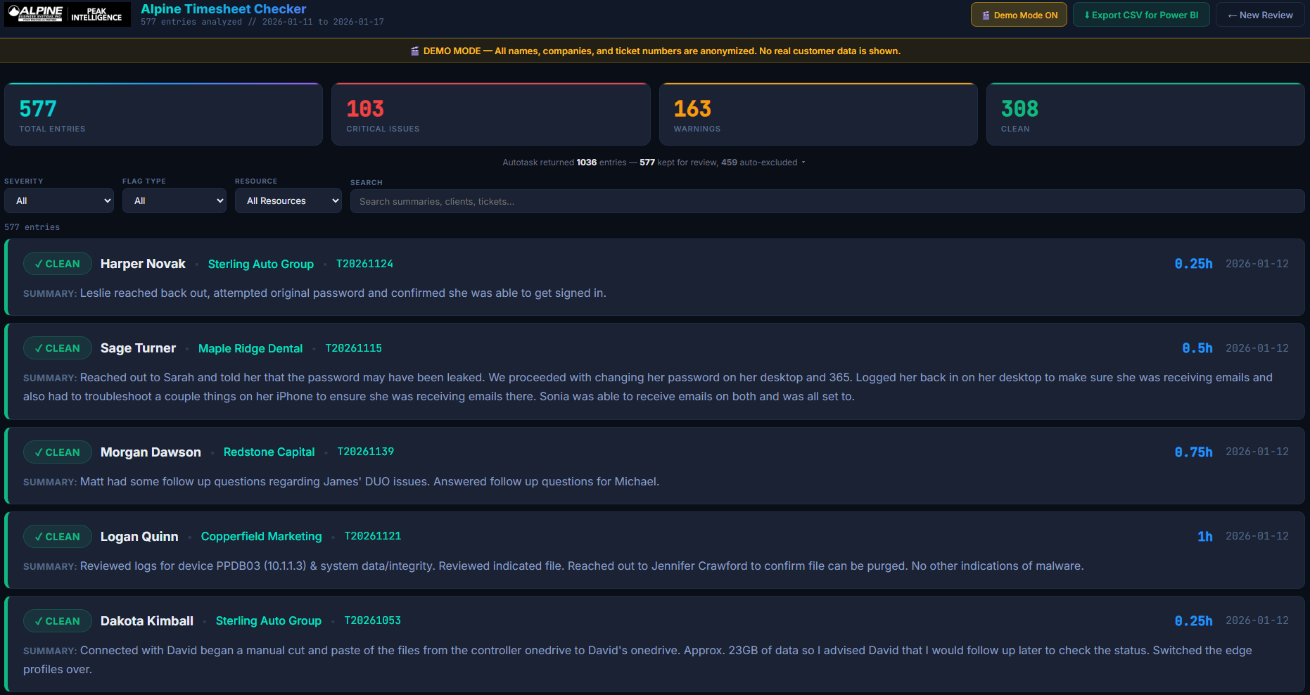
www.alpinebiz.com
908.707.9696

Slide 37
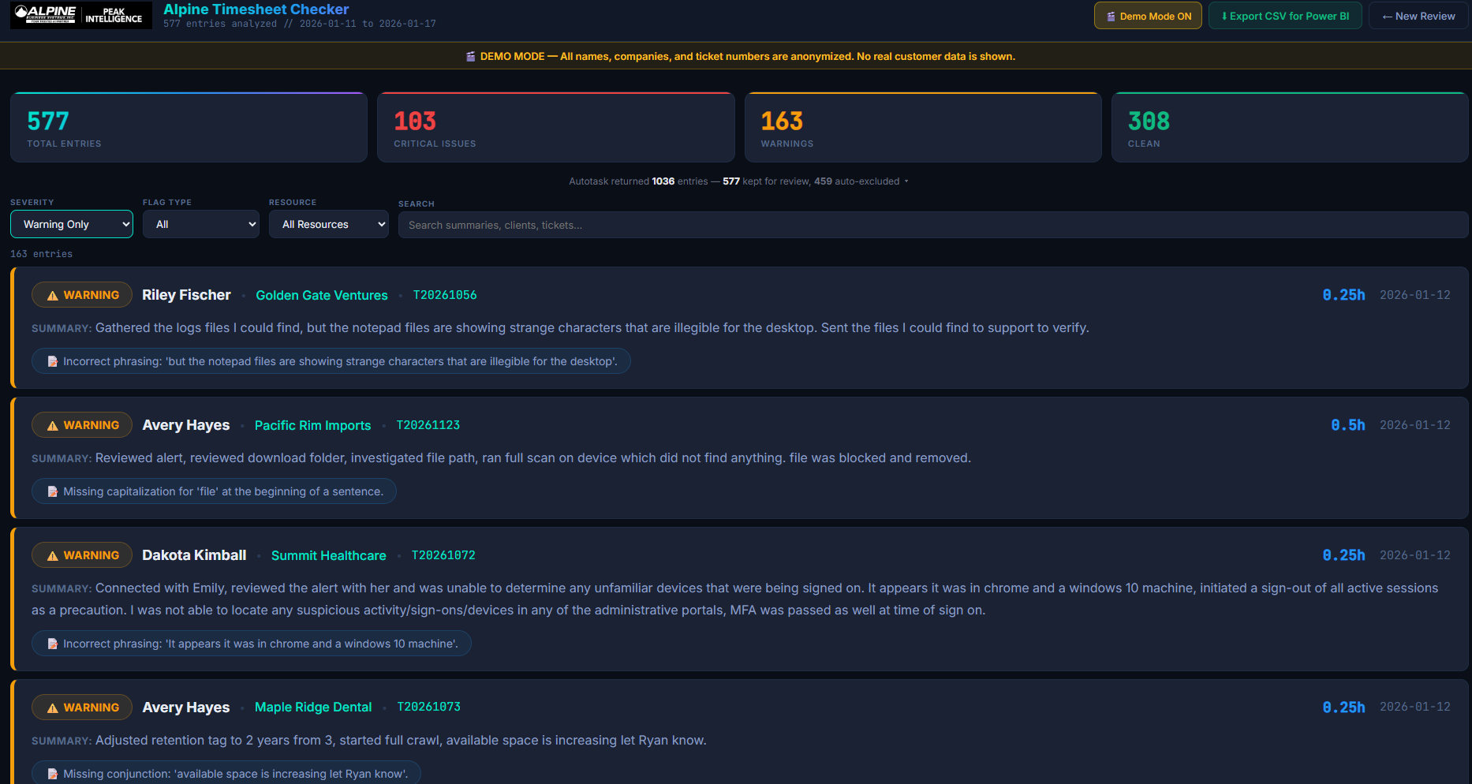
www.alpinebiz.com
908.707.9696

Slide 38
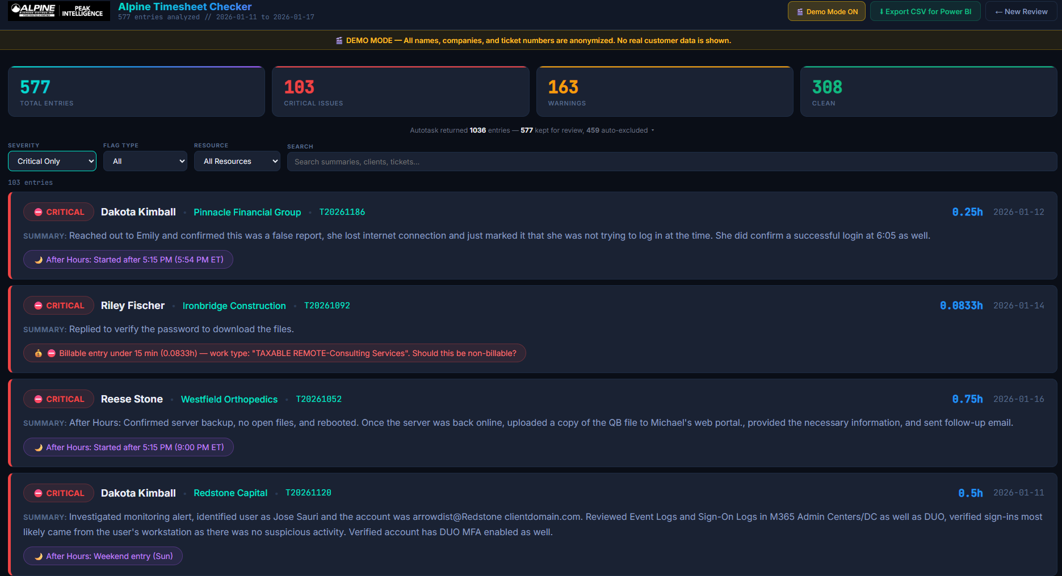
www.alpinebiz.com
908.707.9696

Slide 39
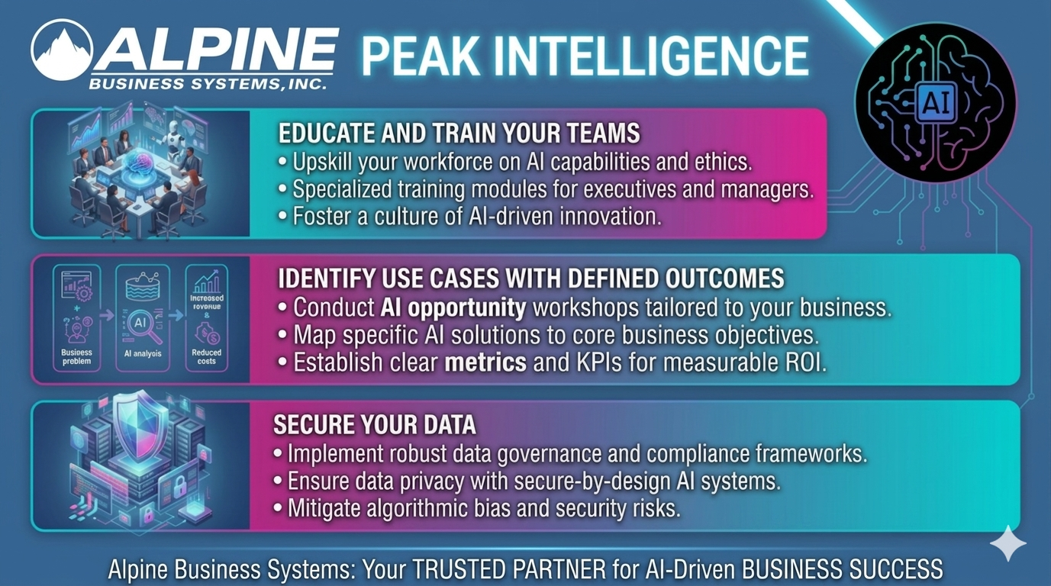
www.alpinebiz.com
908.707.9696

Slide 40
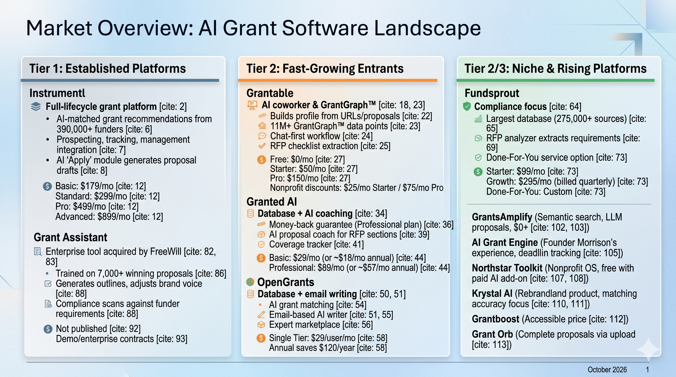
www.alpinebiz.com
908.707.9696

Slide 41
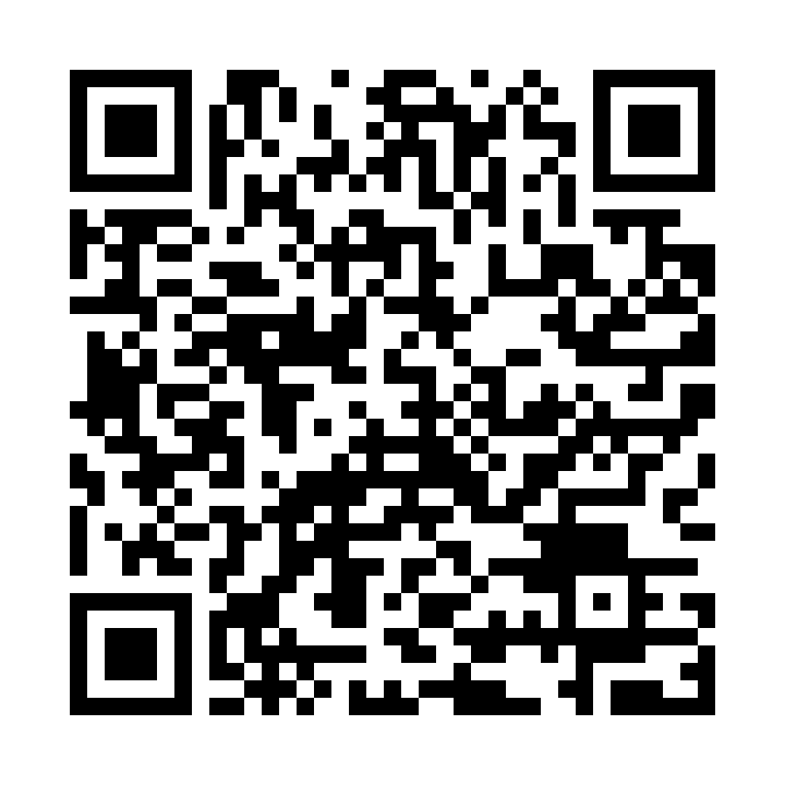
Curious?
solutions@alpinebiz.com
www.alpinebiz.com
908.707.9696

